Slide 1

Instagram User Analytics
Project Done By: Sayan Kashyap

Slide 2
Project Description
This project aims to help the marketing team of Instagram to launch some campaign and give report to our Investor on the basis of some metrics.
We analyze the raw data by using various database management tools and collect useful insights for Instagram to launch appropriate marketing campaigns.

Slide 3
Approach
In order to complete this project we have to work on the data from the provided raw data by using various database management tools.
First of all we create the database and insert the values by using the DDL & DML commands and queries in the MySQL database. After creating the database required insights are generated from the database tables by running SQL queries in MySQL workbench.

Slide 4

Tech-Stack Used
MySQL Workbench v8.0.33: It makes managing and designing databases easy with its user-friendly interface and helps us with visually design databases, build queries, and manage performance without needing to use complex commands.

Slide 5

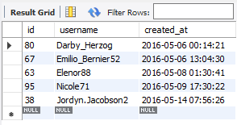
Task A: Marketing Analysis
Loyal User Reward:
SQL Query:
Output:

Slide 6
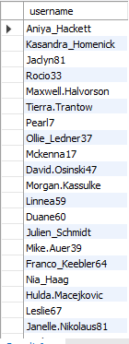
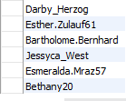
2. Inactive User Engagement:
SQL Query:
Output:

Slide 7
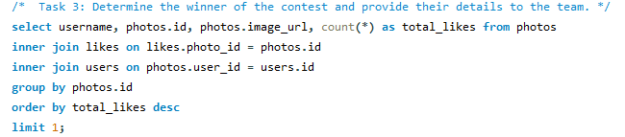

3. Contest Winner Declaration:
SQL Query:
Output:

Slide 8
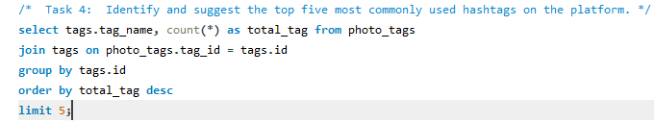
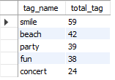
4. Hashtag Research:
SQL Query:
Output:

Slide 9
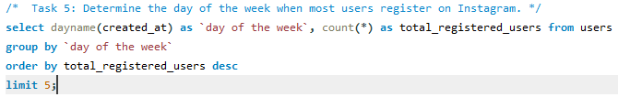
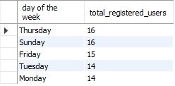
5. Ad Campaign Launch:
SQL Query:
Output:

Slide 10
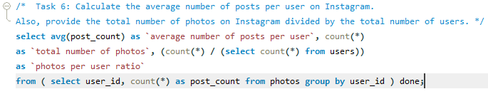

Task B: Investor Metrics
User Engagement:
SQL Query:
Output:

Slide 11
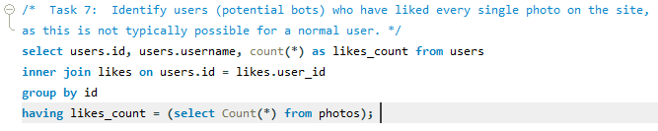
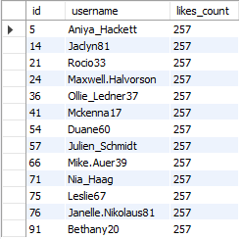
2. Bots & Fake Accounts:
SQL Query:
Output:

Slide 12
Insights
This project helped me understand how complex queries work and how to dig business insights from given data.
In this project we get to know how an organization project work.
This project also helps with so many things like how to handle project or how solve the problem that given in task form.

Slide 13
Result
In this project, SQL queries used to extract insights from database by which we track how users engage and interact with our digital product in an attempt to derive business insights for marketing, product & development teams.

Slide 14
Conclusion
In this project by using the SQL queries we get to know how marketing team can reward the most loyal customers or send promotional emails to inactive users and how to check most popular hashtags or most active day for brand promotions.
We also find how user engagement can be very useful success metric for the growth of the company.
Also we get to know how company can remove the bots and fake accounts from the platform to enhance the user experience.

Slide 15
Thank you

